Slide 1
BGP (Border Gateway Protocol)

Slide 2
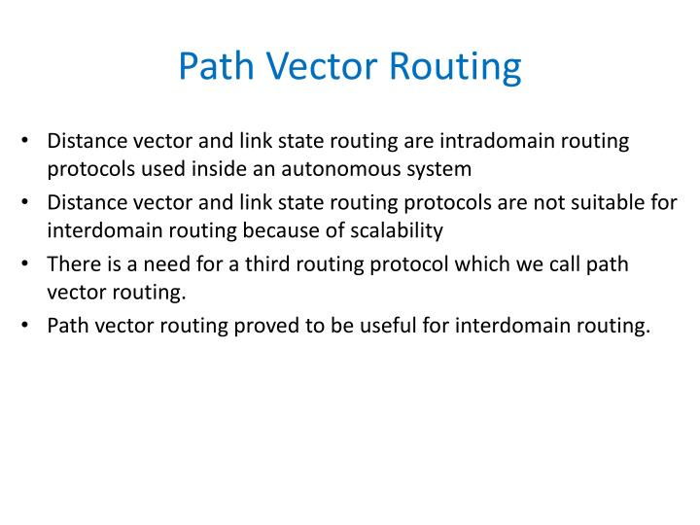

Slide 3
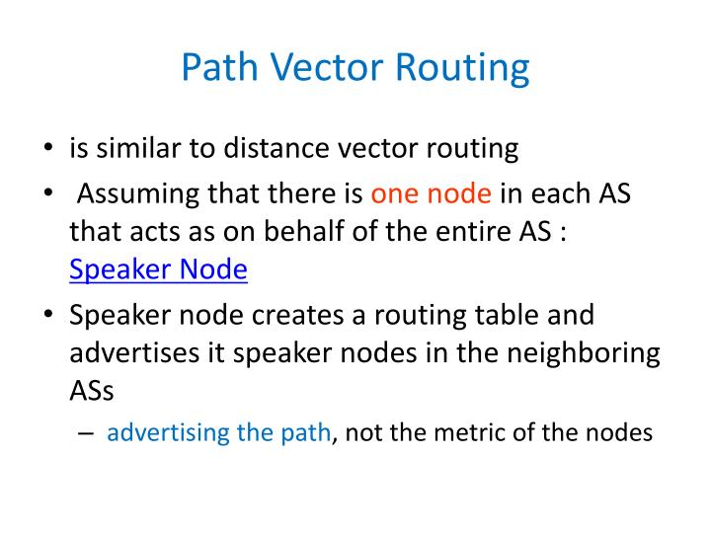
Notes:
AS:Autonomous system(studied in module3)

Slide 4
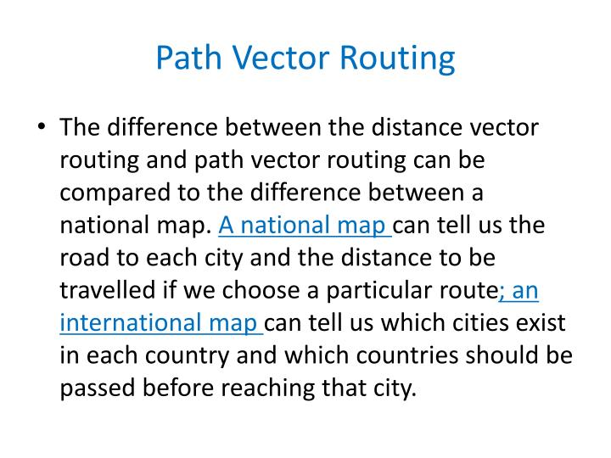

Slide 5
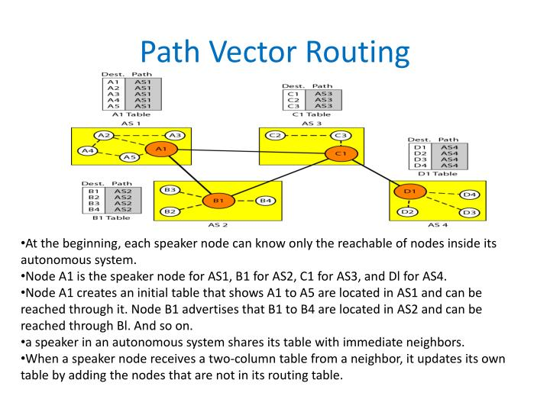

Slide 6
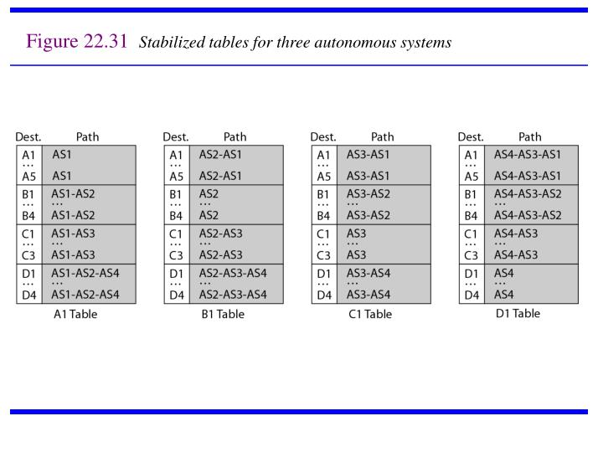

Slide 7
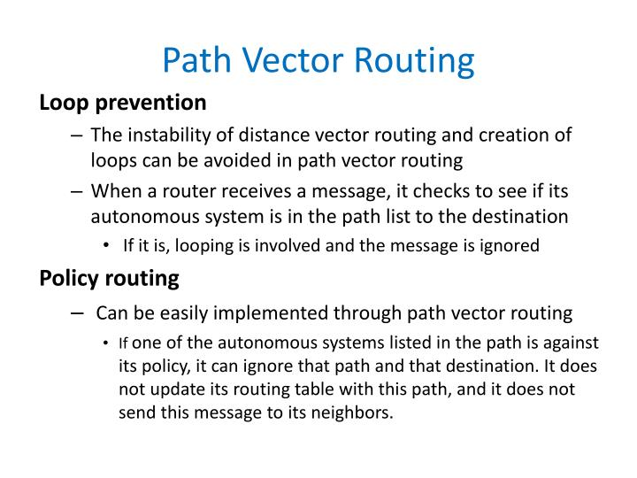

Slide 8
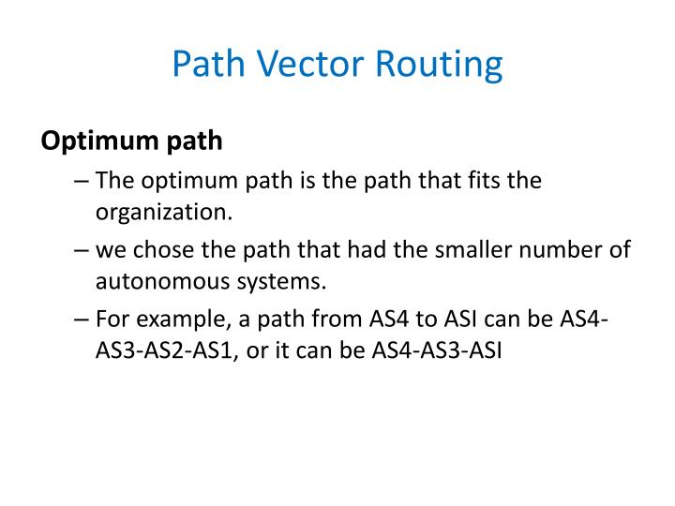

Slide 9
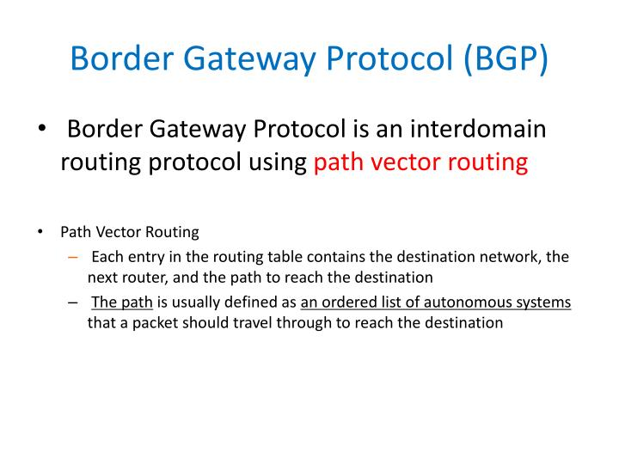

Slide 10
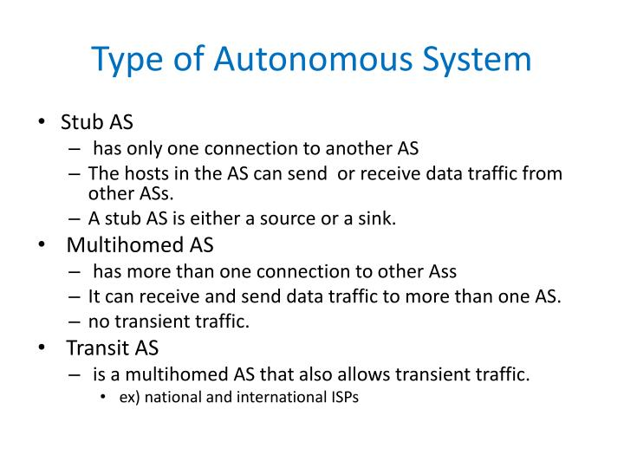

Slide 11
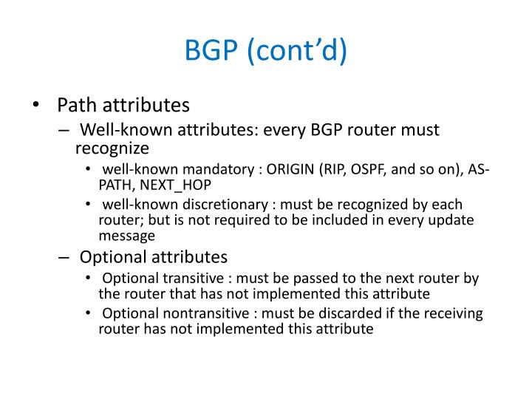

Slide 12
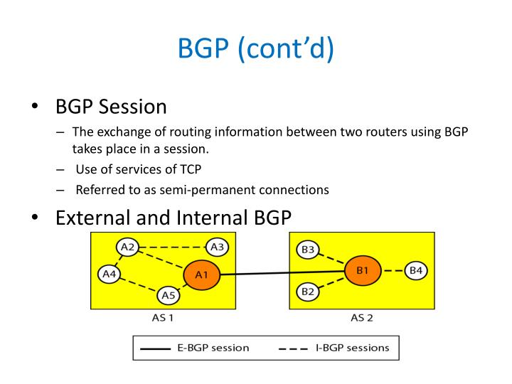

Slide 13
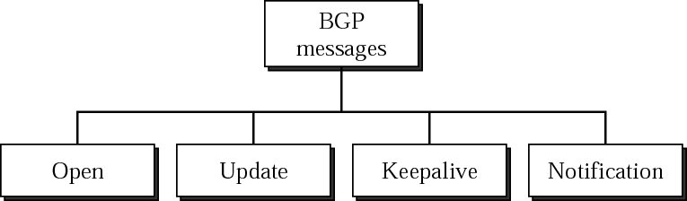
BGP (cont’d)
Messages are sent over TCP connections on port 179.
Functional procedures
Neighbor acquisition (open message, acceptance through Keepalive message)
Neighbor reachability (periodic Keepalive messages)
Network reachability (broadcast an update message)
Each routers maintains a database of networks that can be reached
preferred route to this network.

Slide 14
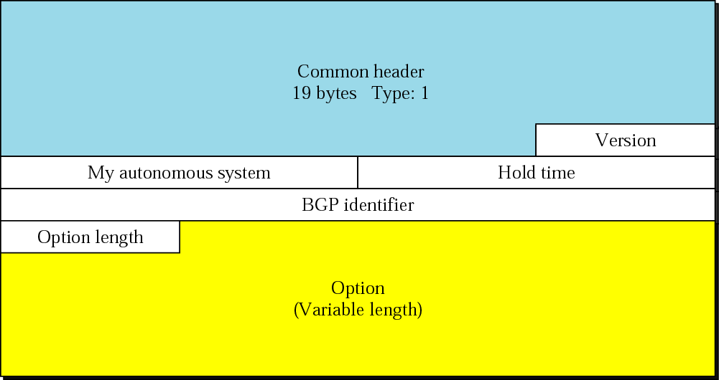
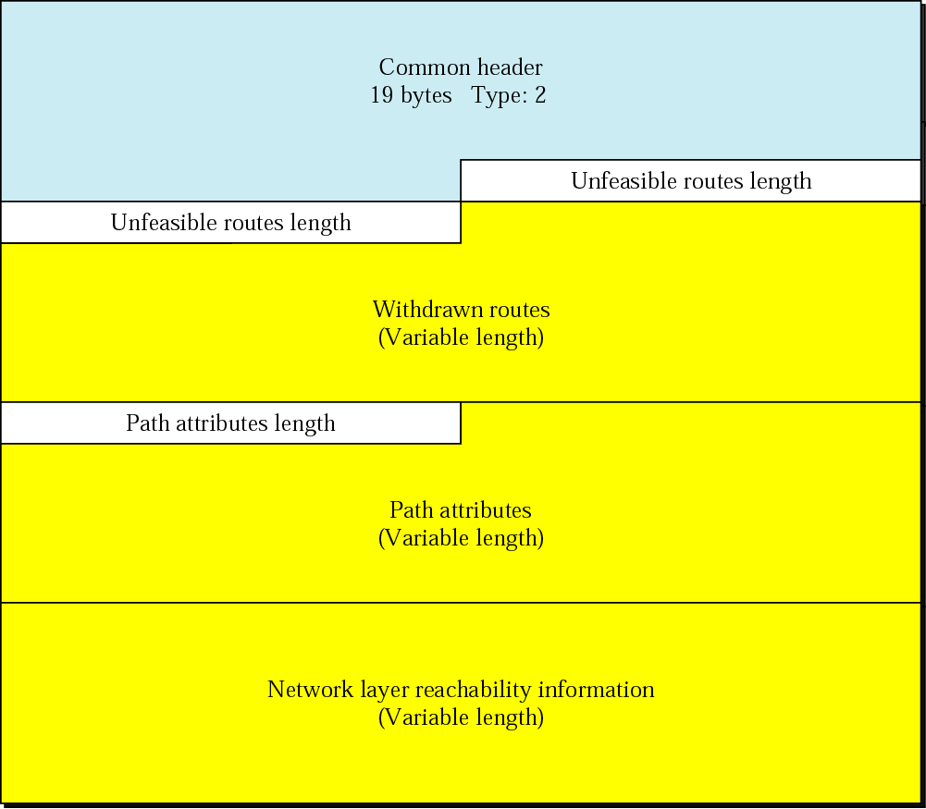

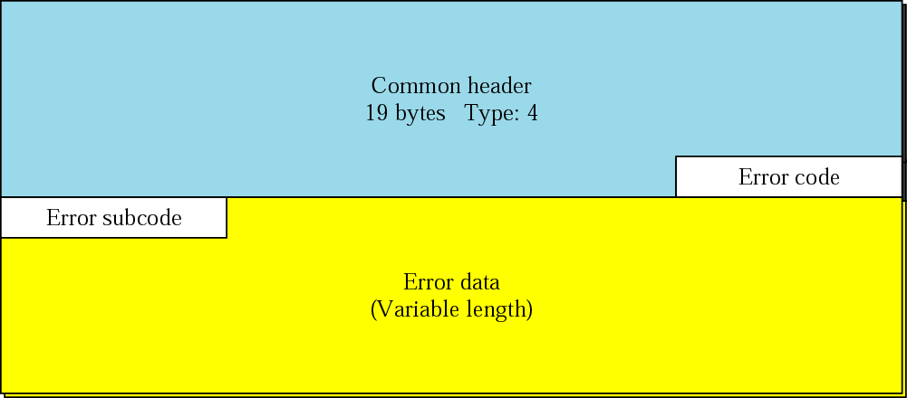
BGP message format (Open, Keepalive, Update, Notification)

Slide 15
BGP Packet Header
Keepalive packet equals the BGP packet header
16B
2B
1B
Variable
Authentication
Length
Type
Data
Packet type

Slide 16
Keepalive Messages
BGP systems exchange keepalive messages to determine whether a link or host has failed or is no longer available. Keepalive messages are exchanged often enough so that the hold timer does not expire. These messages consist only of the BGP header.

Slide 17
BGP Packet Open
1B
2B
2B
4B
1B
4B
Optional
Parameters
Length
Vers
AS
Hold-Time
BGP ID
Optional
Parameters
Max time during
which rtr does not
receive packet before
concluding a problem.
IP address of
a rtr sender

Slide 18
Open Messages
After a TCP connection is established between two BGP systems, they exchange BGP open messages to create a BGP connection between them. Once the connection is established, the two systems can exchange BGP messages and data traffic.

Slide 19
BGP Packet Update
2B
Variable
2B
Variable
Variable
Unfeasible
Routes Lngth
Withdrawn
Routes
Total Path
Attribute Lngth
Path
Attributes
Network Layer
Reachability
List of prefixes being
advertised
Charasteristics of a path
being advertised

Slide 20
Update Messages
BGP systems send update messages to exchange network reachability information. BGP systems use this information to construct a graph that describes the relationships among all known ASs.

Slide 21
BGP Packet Notification
1B
1B
Variable
Error Code
Error Subcode
Error Data

Slide 22
Notification Messages
BGP systems send notification messages when an error condition is detected. After the message is sent, the BGP session and the TCP connection between the BGP systems are closed. Notification messages consist of the BGP header plus the error code and subcode, and data that describes the error.

